Slide 1
RFM Customer Segmentation
Presentation

Slide 2
Problem Statement
The customer data is given as the dataset. There are multiple factors which affect the customer spending, loyalty and purchases for the business. It contains information about customers, their purchases, products, and transaction details.
The data includes various attributes such as customer ID, name, email, phone, address, city, state, zip code, country, age, gender, income, customer segment, last purchase date, total purchases, amount spent, product category, product brand, product type, feedback, shipping method, payment method, and order status.
By analyzing these factors, a business can take steps to increase profits, improve customer service and avoid customer churn.
The major goal of this project is to do an analysis of the given data to draw business insights and then segment the customers using RFM approach.

Slide 3
Approach
RFM : Recency-Frequency-Monetary.
These are the 3 main attributes by which we can segment our customers for better advertising as well as customer service.
Recency: How recently the customer has made purchases. A customer who is more recent has better value for the business and their feedback has higher impact.
Frequency : How frequently a particular customer has made purchases. Naturally, these are loyal customers and new discounts or offers can be given to such customers.
Monetary: How much money is a customer spending on his purchases. The higher the spending, the more valuable the customer

Slide 4
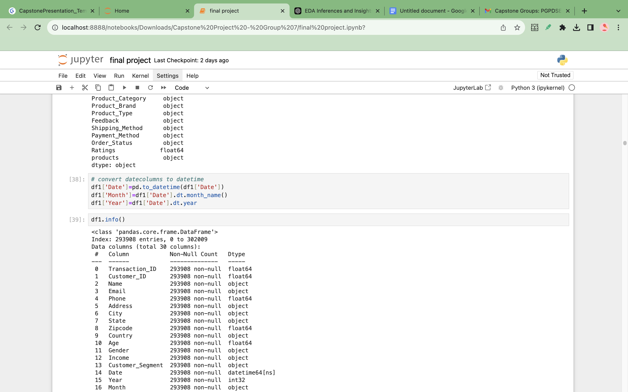
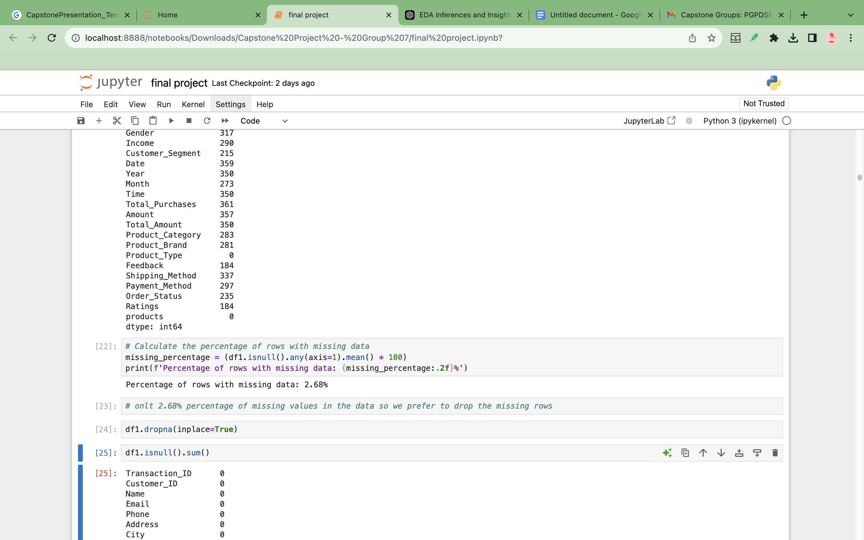
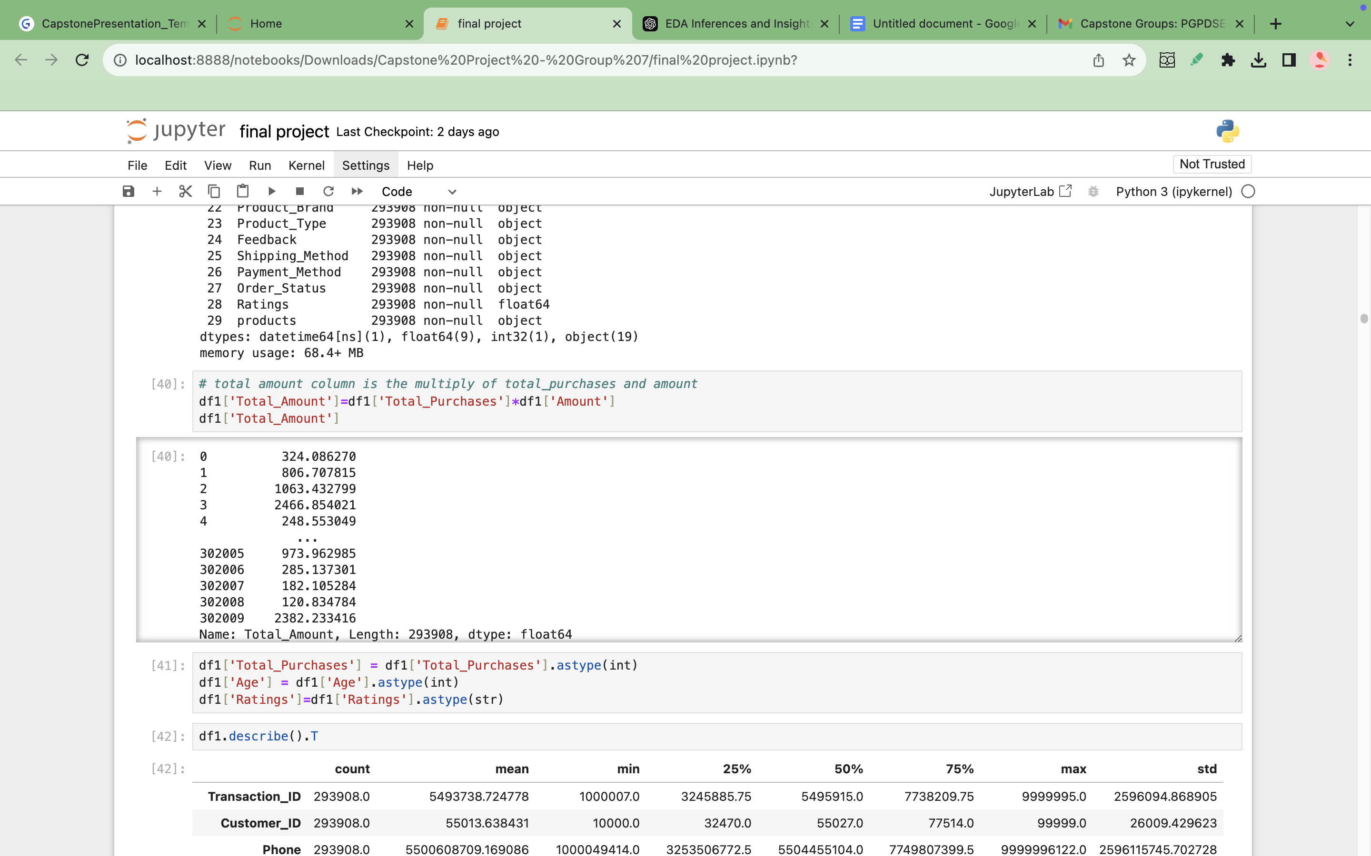
Null Value Treatment
Data Cleaning & Preprocessing
There were no duplicate values present in the dataset
There were no anomalies in unique categories in categorical data
Datatype of the columns: date, month, year were changed from object to datetime
The table represents the total number of null values in each variable.
The total amount of null values accounted for a meagre 2.68%.
We decided to drop the null values instead of treating them, since they accounted for a minimal value.
Feature Engineering
A new numerical column was created to view the total amount spent by each customer
This was created by retrieving the product of total number of purchases and amount

Slide 5
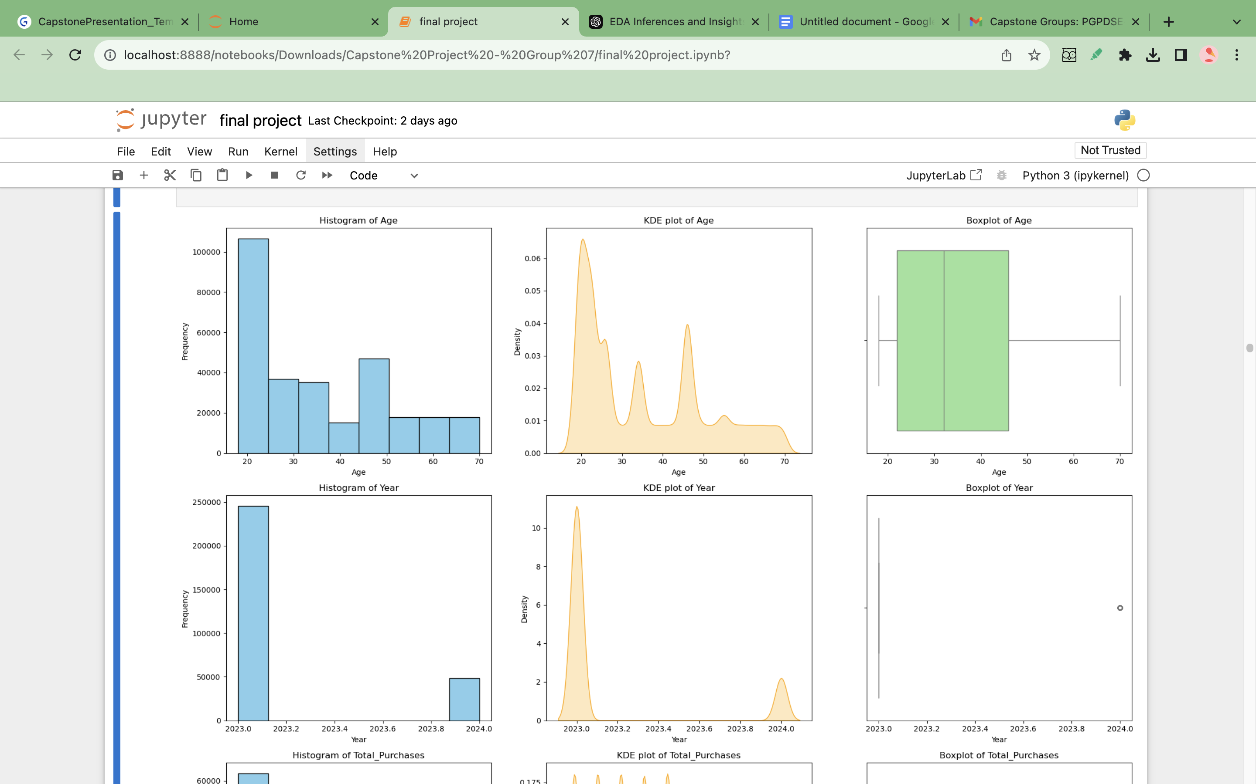
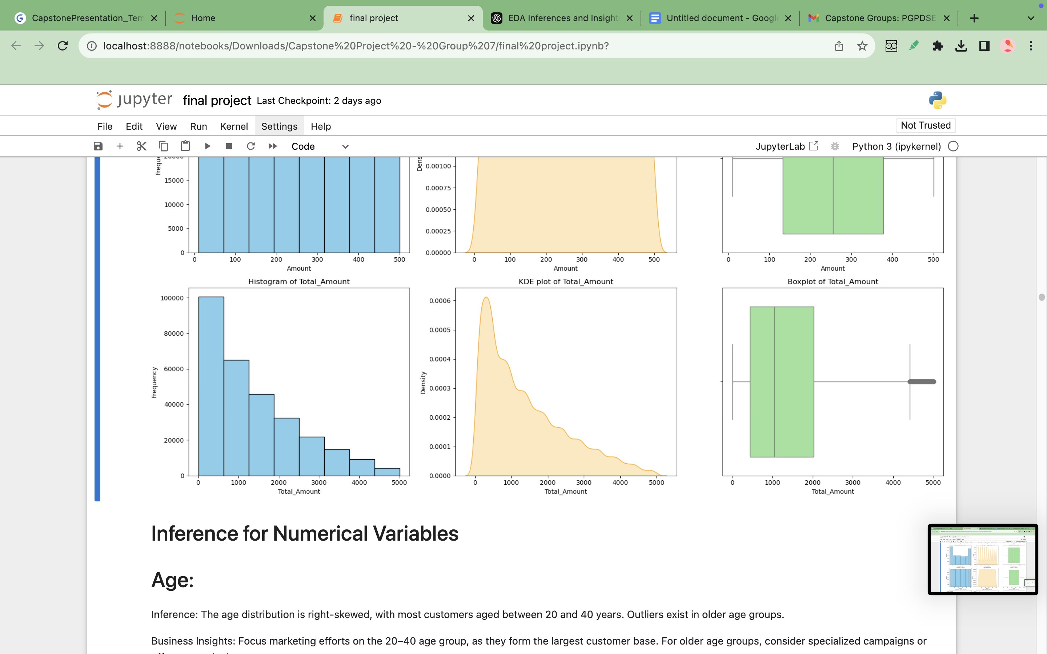
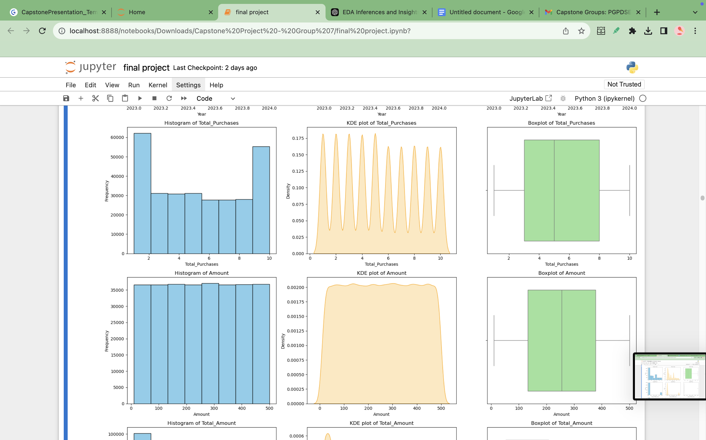
KDE Plot for numerical features
Skewness if Total Amount feature is 0.97, Age is 0.65, Year is 1.80, Total purchases is 0.07, Amount is -0.002.
The total number of outliers accounted for 51742.
Almost all the numerical variables were normally distributed except for Total Amount.

Slide 6
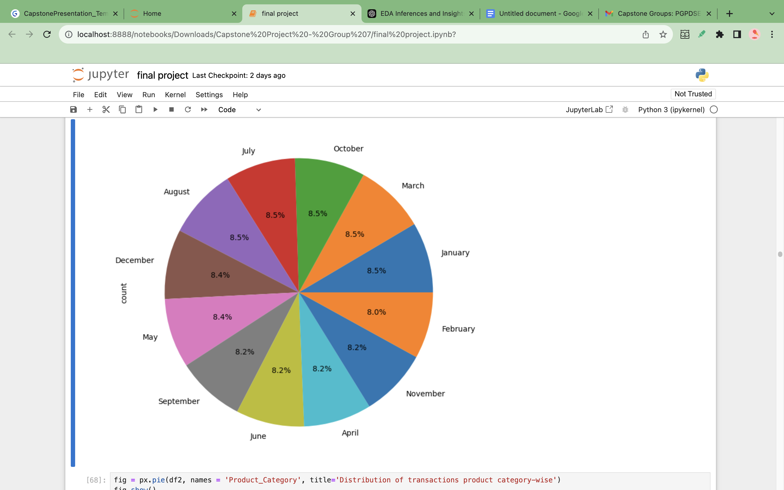
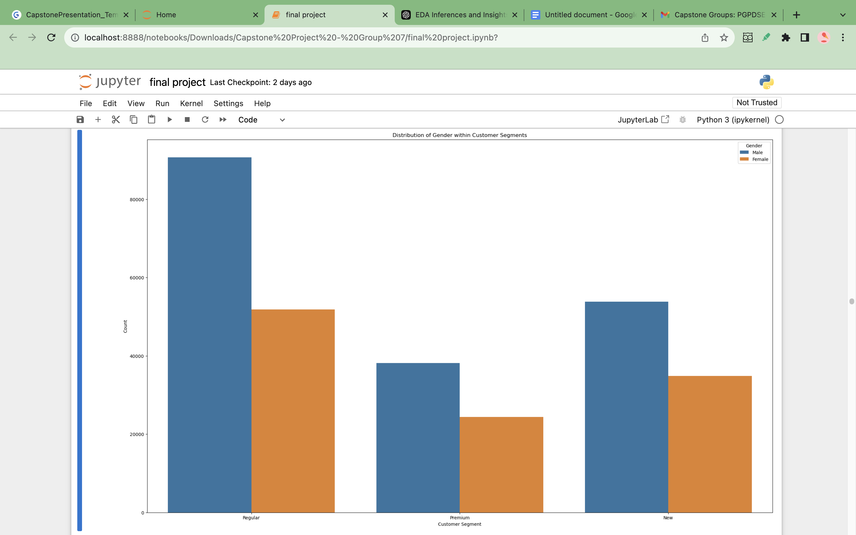
Customer segmentation based on various features
Distribution of Categorical Variables
The pie chart represents month wise purchase by customers
Almost all the months have equal footfall in terms of purchase
The plot below gives the customer segmentation based on gender.
The Male category dominates female in all three aspects of customer segments such as Regular, Premium and New.

Slide 7
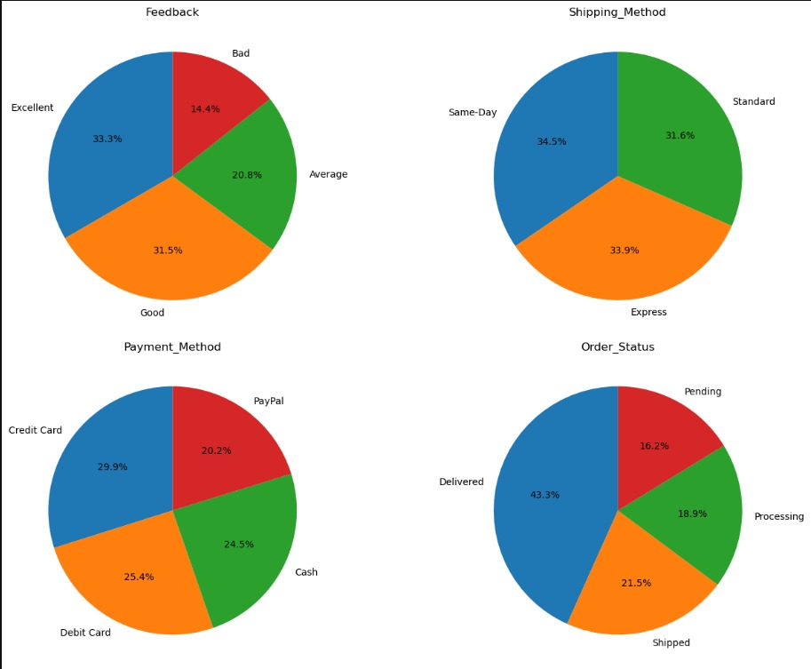
Distribution of customers based on categorical variables
Customers who prefer credit card are the maximum compared to other modes of payment.
Excellent and Good reviews account to almost 65% of the total reviews.
All three shipping methods are equally preferred by the customers.
Only 16.2% of the orders were in pending status, with 44% of the orders delivered on time.

Slide 8
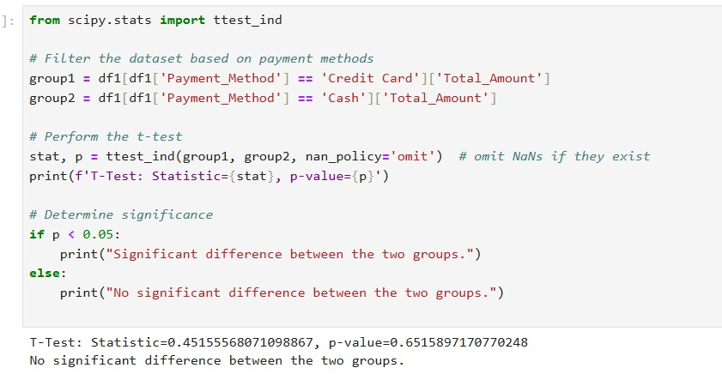
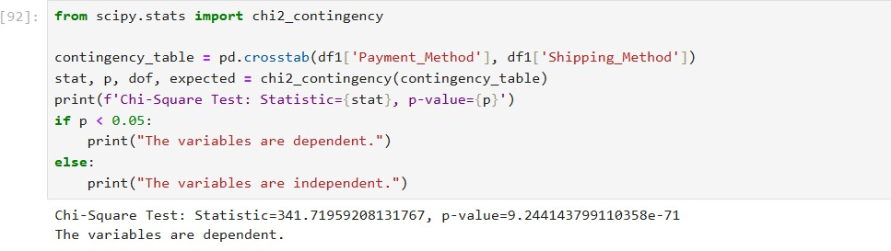
Hypothesis Testing
T-Test Results:
There is no significant difference in the average total amount spent by customers using Credit Cards versus Cash (p = 0.6516).
Payment method does not influence spending behavior. Marketing campaigns or incentives targeting specific payment methods may not result in higher sales.
Chi-Square Test Results:
There is a dependence between `Payment_Method` and `Shipping_Method` (p < 0.05).
Customers' choice of shipping method is influenced by how they pay. Businesses can optimize shipping promotions tailored to payment methods, e.g., offering free express shipping for credit card users to encourage its adoption.

Slide 9
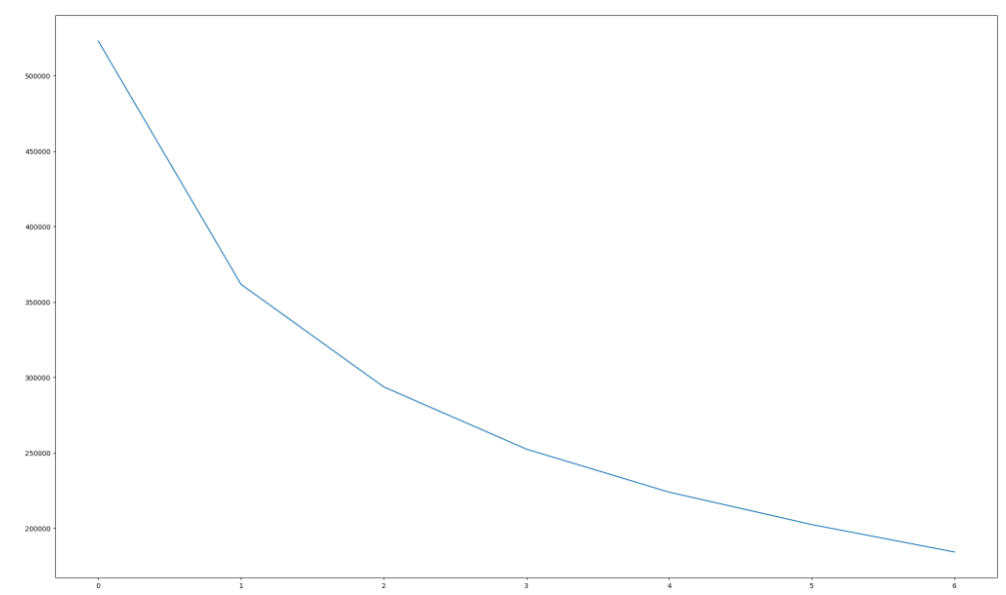
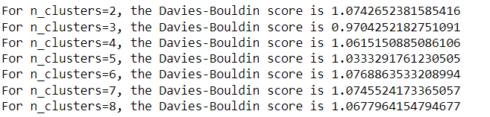
Base Model : K-Means Clustering
Elbow plot was used to find the optimal clusters. The "elbow" appears to be around 3 clusters, as the curve starts to flatten after this point.
This suggests that adding more clusters beyond 3 yields diminishing returns in reducing within-cluster variance.
The optimal number of clusters for our customer segmentation is 3.
For n = 3, we have a Davies-Bouldin Score of 0.97:
Our model has a relatively low score, indicating that the clusters are well-separated and compact, which is a good result for clustering.
This score aligns with the inference from the elbow method, suggesting that the clustering configuration (likely around 3 clusters) effectively captures distinct customer segments with minimal overlap.
In summary, a Davies-Bouldin Score of 0.97 suggests that the clustering model has created meaningful, well-defined customer segments.

Slide 10
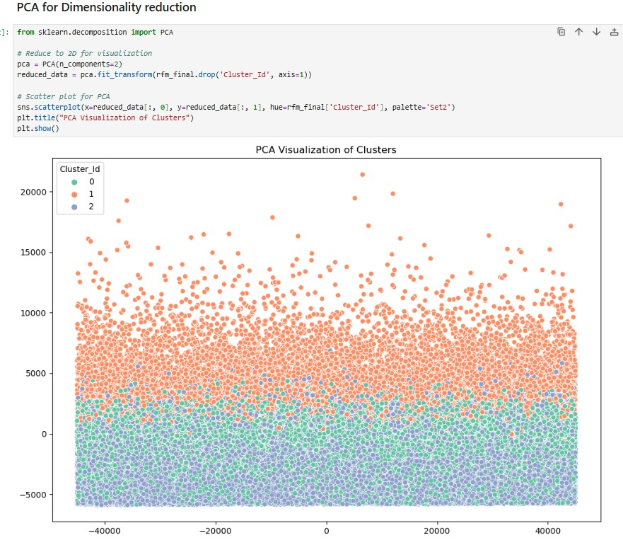
Dimensionality Reduction using Principal Component Analysis(PCA)
PCA was applied in this RFM-based clustering project to enhance computational efficiency and potentially improve clustering performance by reducing dimensionality and eliminating any latent correlations within the RFM features.
The data points are clearly divided into 3 distinct clusters, represented by the green, orange, and blue colors.
The clusters are distributed across a wide range on both the x and y axes, indicating significant variation in the underlying features.
The clusters have varying densities, with the green cluster being the most densely populated and the blue cluster being more dispersed.
There appear to be some outliers or data points that don't neatly fit into the main clusters, especially in the upper right quadrant.

Slide 11
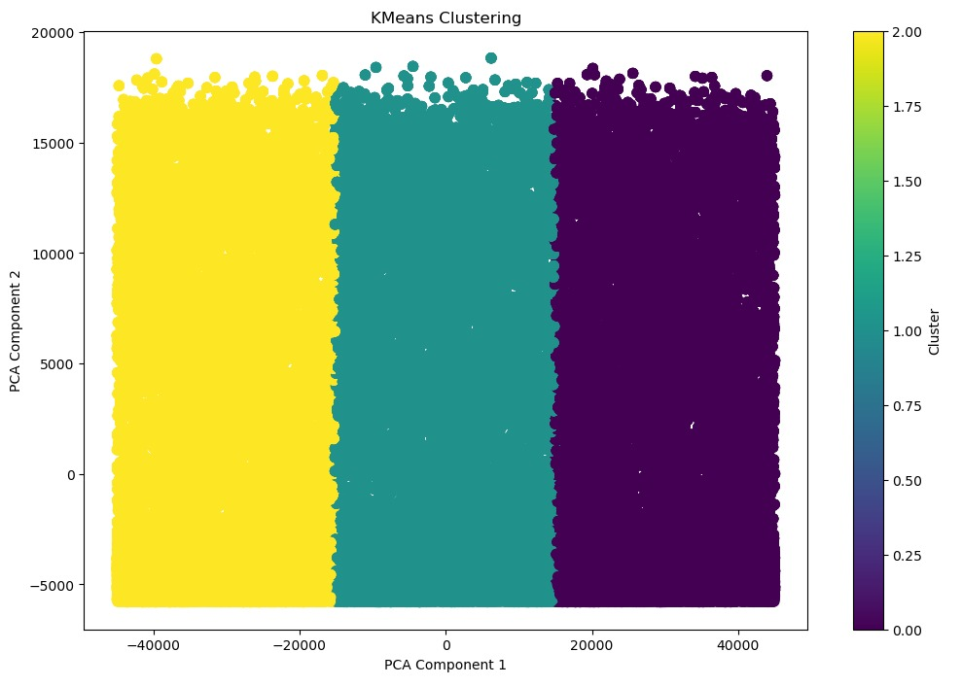
K-Means Clusters
Silhouette Score: 0.477214
Davies Bouldin Index: 0.703878

Slide 12
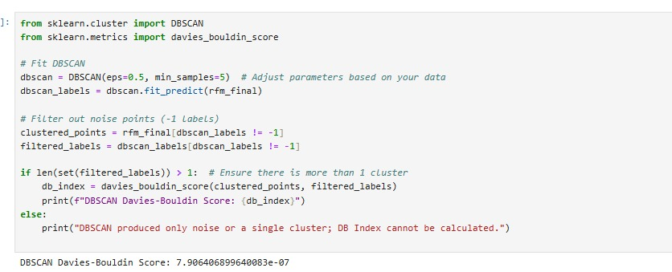
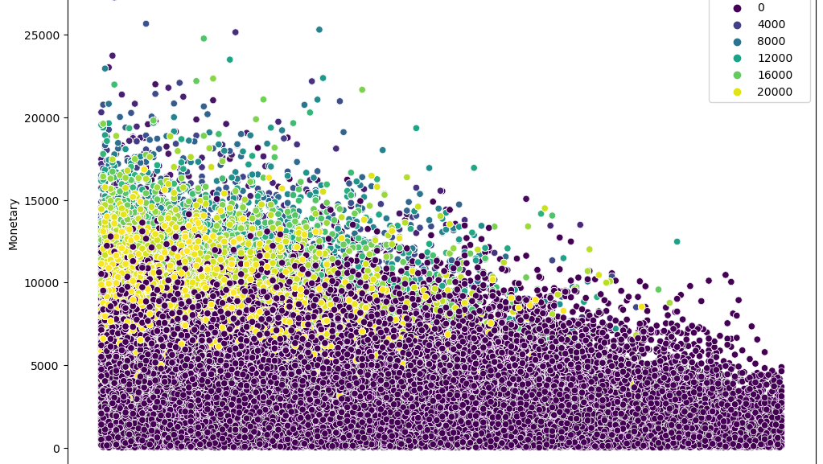
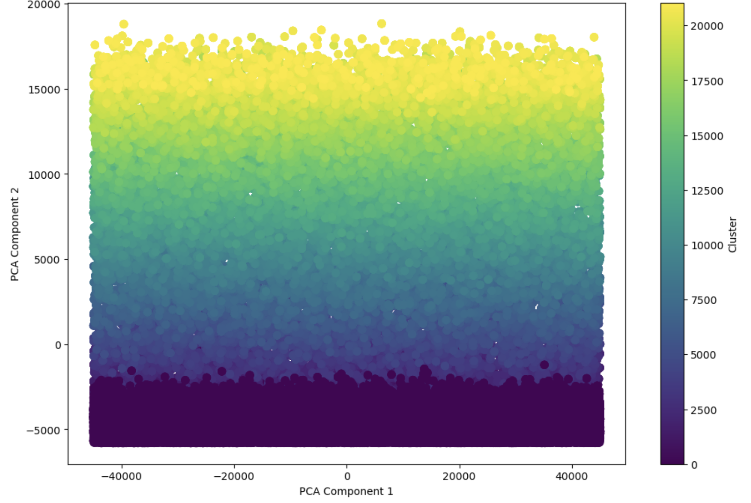
DBSCAN Clusters
Silhouette Score: -0.144984

Slide 13
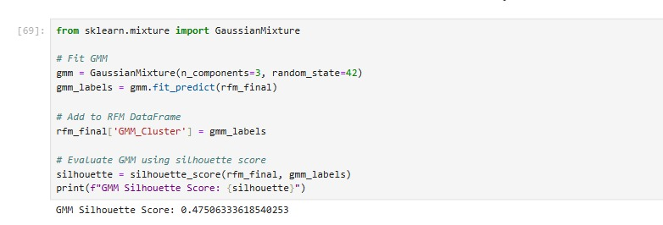
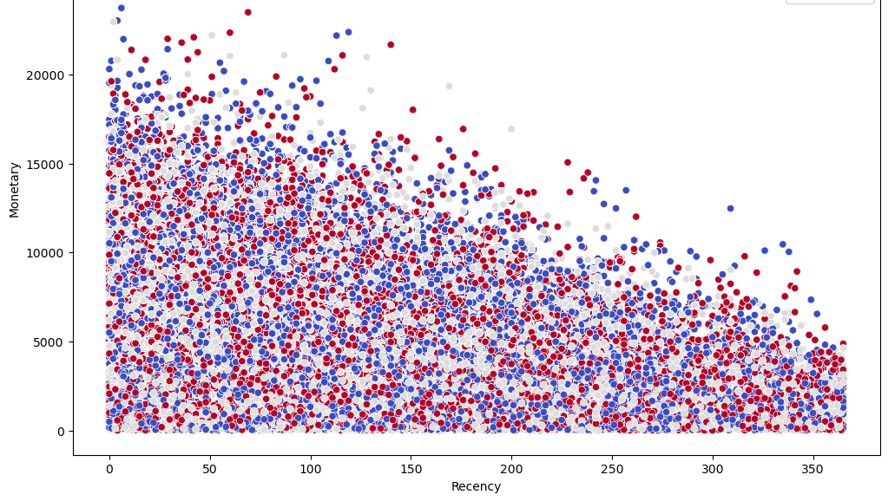
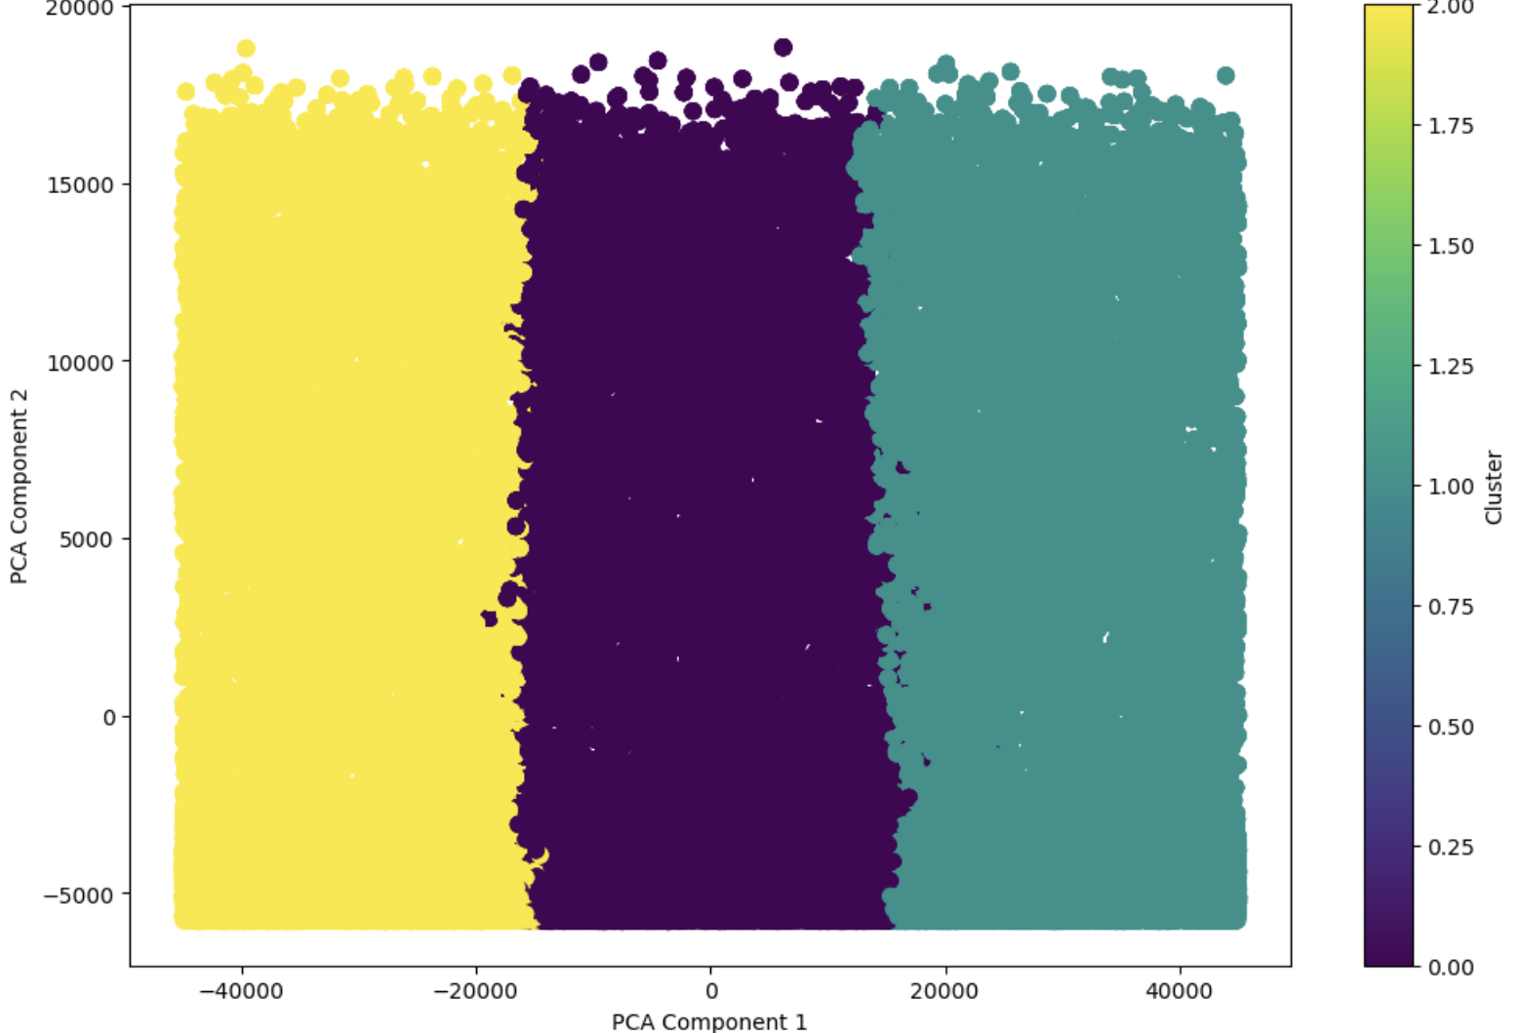
GMM Clusters

Slide 14
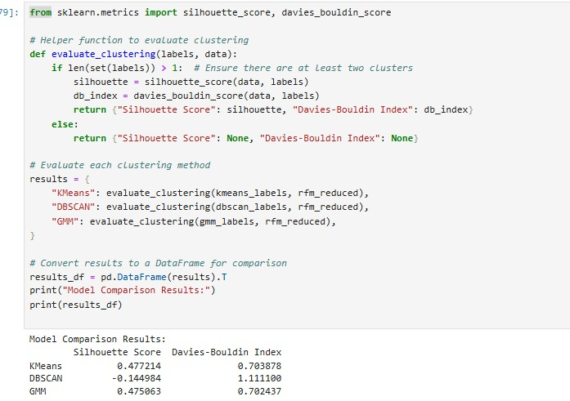
K-Means:
Silhouette Score – Indicates moderately well-defined clusters.
Davies-Bouldin Index – Clusters are compact and well-separated.
DBSCAN:
Silhouette Score – Negative value suggests poorly formed clusters, likely due to outliers or noise dominating the result.
Davies-Bouldin Index: – Higher value indicates suboptimal clustering.
GMM (Gaussian Mixture Model):
Silhouette Score – Slightly lower than K-Means but still indicates moderately defined clusters.
Davies-Bouldin Index – Slightly better separation than K-Means.

Slide 15
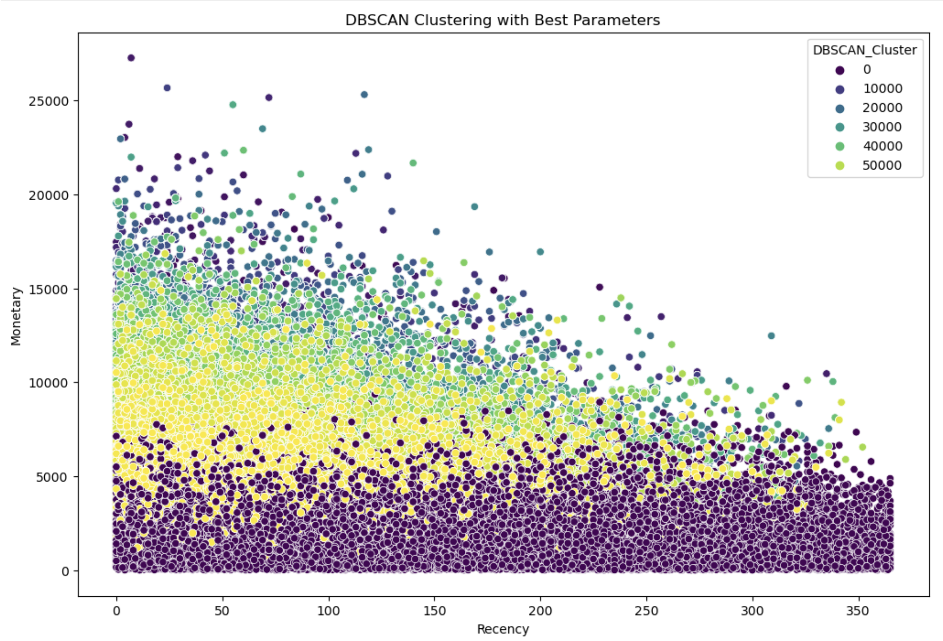
Hyperparameter Tuning for DBSCAN
For K-Means and GMM, the Silhouette Score and Davies-Bouldin Index were calculated after selecting the optimal number of clusters, so further tuning was not required.
However, DBSCAN exhibited poor initial performance, necessitating hyperparameter tuning for `eps` and `min_samples`, as these directly influence the formation of clusters.
After tuning, with Best Parameters: {'eps': 0.3, 'min_samples': 3}, the Silhouette Score significantly improved from -0.144984 to 0.67, demonstrating its ability to identify well-defined clusters with the adjusted parameters.

Slide 16
Strategies for customers in each clusters
Cluster 0 (Dark Purple): Inactive/Low-Value Customers
Characteristics:
High Recency (R): Customers who haven’t purchased recently & Low Monetary (M): Low spending behaviour.
Likely sporadic buyers or customers who are at risk of churning.
Strategies:
Reactivation Campaigns: Send personalized reminders about products they previously browsed or purchased.
Discount Offers: Provide attractive discounts or free shipping to encourage re-engagement.
Exit Surveys: Request feedback to understand their inactivity and improve your offerings.
Cluster 10000-20000 (Yellow): Loyal Customers
Characteristics:
Low Recency (R): Recent purchases & High Monetary (M): Spend significantly.
These are profitable, engaged customers.
Strategies:
Loyalty Programs: Reward their loyalty with points, cashback, or exclusive benefits.
Exclusive Offers: Provide early access to sales, premium services, or product launches.
Personalized Engagement: Send tailored emails highlighting products they may be interested in.
Cluster 30000-40000 (Blue/Teal): Potentially Valuable Customers
Characteristics:
Moderate Recency (R): Last purchase was not very recent & Moderate to High Monetary (M): Show potential but need nurturing.
Strategies:
Engagement Campaigns: Keep them engaged with personalized promotions or emails.
Cross-Selling: Suggest complementary products based on their previous purchases.
Festive Campaigns: Leverage seasonal campaigns to bring them back into the active zone.
Cluster 50000 (Green): New or Sporadic Customers
Characteristics:
High Recency (R): Recent purchases & Low to Moderate Monetary (M): Spending is limited or irregular.
Strategies:
Educational Campaigns: Highlight the benefits and quality of your products/services.
First-Time Offers: Give discounts or loyalty benefits for their next purchase.
Engagement Follow-Up: Send follow-up emails encouraging repeat purchases or feedback.

Slide 17
THANK YOU

